Slide 1

U.S. MARINE CORPS FORCES, SOUTH
2013 HURRICANE INFORMATION
HANDBOOK
UPDATED: 17 MAY 2013

Slide 2
TABLE OF CONTENTS
Hurricane Overview . . . . . 3
Hurricane Associated Dangers & Threats . . . .
High Winds . . . . . 4
Tornados and Downbursts . . . . 5
Storm Surge and Inland Flooding . . . 6
MARFORSOUTH Destructive Weather Plan (OPLAN 1-01) . . . . 7
Hurricane Preparedness
Broward Evacuation Shelters . . . . 12
Generator Equipped Grocery Stores (Broward County) . . 13
Gas Stations Pre-wired for Generators Power (Broward County) . 14
Broward Storm Surge Zones . . . . 15
Broward County Routes . . . . 16
Miami-Dade Evacuation Shelters . . . 17
Generator Equipped Grocery Stores (Miami-Dade) . . 18
Gas Stations Pre-Equipped Grocery Stores (Miami-Dade) . . 19
Miami-Dade Storm Surge Zones . . . 20
Miami-Dade County Routes . . . . 21
Hurricane Preparation Checklists
Before Season . . . . . 22
During Approach . . . . 23
During Hurricane . . . . 24
Post Destructive Weather . . . . 25
Evacuation Kit Checklist . . . . . 26
Hurricane Survival Kit Checklist . . . . 27
Additional Broward /Miami Dade Services . . . . 29
Vulnerable Population Registration
Special Medical Needs
Emergency Evacuation Assistance Program
Important Phone Numbers . . . . . 30

Slide 3
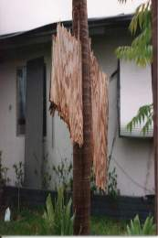
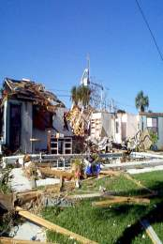
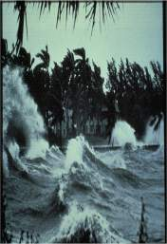
HURRICANE OVERVIEW
The term hurricane is a regionally specific name for a strong tropical cyclone. A tropical cyclone is a non-frontal synoptic scale low-pressure system over tropical or sub-tropical waters with organized convection (e.g. thunderstorm activity) and definite cyclonic surface wind circulation. Tropical cyclones with maximum sustained surface winds of less than 39 mph are called tropical depressions. Once a tropical cyclone reaches winds of at least 39 mph, it is typically called a tropical storm and assigned a name. If winds reach 74 mph, then the tropical storm becomes a hurricane.
The Atlantic hurricane season officially starts 1 June and ends 30 November each year; however, hurricanes have occurred outside of this six month period. The eye, or center, of a hurricane can be relatively calm. The edges of the eye can be the most powerful portion of the storm. Hurricane hazards include wind (including tornados), rain, and storm surge. Tropical Storm Force Winds (TSFW), which are 39 mph or greater, may extend more than 200 miles out from the eye of a storm. TSFWs may arrive as much as 30 hrs prior to the eye of a storm, depending upon the forward speed of the storm.
Hurricanes occasionally produce sustained winds equal to or higher than tornado intensity. Weakening hurricanes frequently produce tornadoes, especially when they make landfall. TSFWs cause major property damage; however , more than 80% of hurricane related deaths are due to inland fresh water flooding caused by heavy rainfall. Hurricanes also frequently produce storm surge, a large dome or mound of water that overrun the coast line and inundate inland areas.
Notes:
The center of the storm is called the “eye.”

Slide 4
HIGH WINDS
The onset of TSFWs is the threshold for a destructive weather event. TSFWs can have effects up to thirty hours in advance of the eye of a storm and are measured in accordance with the Saffir-Simpson Scale for destructive effects. The Scale estimates damage resulting from the correlative category due to high winds, tornados and flooding.
Winds in coastal areas are generally stronger due to less friction over water and sustained winds in inland areas are generally lower than near coasts. Winds from hurricanes can reach hundreds of miles inland with some wind gusts reaching speeds equal to F4 tornado intensity (>200 mph).
The effects of the wind on structures is not linear (e.g. not a one-to-one ratio).The force of the wind on structures increases by the square of the velocity. For examples, a wind speed of 100 mph creates an effect 1900 units greater than a wind speed of 90 mph, even though the difference in speed is only 10 mph. However, the same 10 mph difference between 130 mph and 140 mph creates an effect 2700 units greater.
Saffir-Simpson Scale
Category | Winds | Effects
One | 74-95 mph | No real damage to building structures. Damage primarily to unanchored mobile homes, shrubbery, and trees. Also, some coastal road flooding and minor pier damage
Two | 96-110 mph | Some roofing material, door, and window damage to buildings. Considerable damage to vegetation, mobile homes, and piers. Coastal and low-lying escape routes flood 2-4 hours before arrival of center. Small craft in unprotected anchorages break moorings.
Three | 111-130 mph | Some structural damage to small residences and utility buildings with a minor amount of curtain wall failures. Mobile homes are destroyed. Flooding near the coast destroys smaller structures with larger structures damaged by floating debris. Terrain continuously lower than 5 feet ASL may be flooded inland 8 miles or more.
Four | 131-155 mph | More extensive curtain wall failures with some complete roof structure failure on small residences. Major erosion of beach. Major damage to lower floors of structures near the shore. Terrain continuously lower than 10 feet ASL may be flooded requiring massive evacuation of residential areas inland as far as 6 miles.
Five | greater than 155 mph | Complete roof failure on many residences and industrial buildings. Some complete building failures with small utility buildings blown over or away. Major damage to lower floors of all structures located less than 15 feet ASL and within 500 yards of the shoreline. Massive evacuation of residential areas on low ground within 5 to 10 miles of the shoreline may be required.

Slide 5
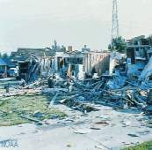
TORNADOS AND DOWNBURSTS
Tornados are violent, swirling, funnel-shaped clouds that extend to the ground. Winds can range from 40-318 mph and their path of damage can be as long as 50 miles. Tornados uproot trees, destroy buildings, and turn harmless objects into deadly projectiles. Tornadoes and damaging straight-line winds from downbursts can develop in the outer thunderstorm bands hundreds of miles away from the eye of the hurricane.
Nearly 70% of land falling hurricanes from 1948 to 2000 spawned at least 1 tornado, with 40% of hurricanes making land-fall spawning more than 3 tornadoes. Nearly one-third of these tornados develop before the hurricane center reaches the coastline and can occur up to 150 miles inland. Many tornados occur outside the region of the strongest surface wind gusts, with the majority occurring in the right front quadrant (relative to the storm motion) of a hurricane. Tornados incident to hurricanes occur sporadically and are often short in duration, making them difficult to predict. Hurricanes can produce dozens of tornados, some historical examples of which are: Hurricane Beulah (1967): 141; Hurricane David (1979): 24; Hurricane Allen (1981): 29; and, Hurricane Andrew (1992): 29.
Fujita Tornado Intensity Scale

Slide 6
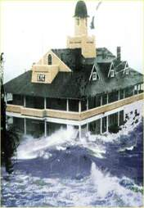
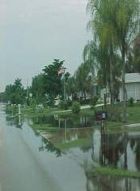
STORM SURGE, RAIN & INLAND FLOODING
Storm surge is the abnormal rise in water created by wind blowing across the water surface and the low atmospheric pressure in or near the eye of a hurricane. Storm surge domes can be 20 feet high and 50-100 miles wide. Storm surge can lead to inland flooding, which can be compounded by heavy rains. More people are killed by flooding than any other hurricane threat. These deaths are often attributable to being trapped in, or attempted to escape from, vehicles stranded in flooded areas. Most deaths are the direct result of people trying to drive through flooded roadways.
Storms tend to produce less rain as they move away from oceans; however, their intensity, as well as how far they move inland, also affects rain-fall. Rain during hurricanes can be torrential and can cause flash flooding absent a storm surge. Intense rainfall from slow moving hurricanes can be destructive and often damages roofs, allowing water to enter attics, walls, and indoor living spaces. Heavy rains create hidden health dangers such as mold, contaminated food, sewage backups and waterborne disease. Rains and inland flooding increase in the rate of fatal car crashes as a result of poor visibility, hydroplaning and vehicular systems failure.

Slide 7
DESTRUCTIVE WEATHER PLAN (OPLAN 1-01)
The MARFORSOUTH Destructive Weather Plan (OPLAN 1-01) sets forth the following mission, execution and concept of operations statements:
3. Mission. On order, MARFORSOUTH conducts operations to mitigate the effects of destructive weather in order to protect: facilities and associated government property; classified materials and information systems; and, personnel, their families and residences, while concurrently maintaining the capability to maintain continuous command and control of OPCON forces and communication with higher, adjacent and subordinate headquarters.
4. Execution
a. Commander’s Intent. Commander, Marine Corps Forces, South (COMMARFORSOUTH) will take all reasonable actions to mitigate the effects of destructive weather on MARFORSOUTH facilities and associated government property; classified materials and information systems, and; personnel, their families and residences. MARFORSOUTH will coordinate with USSOUTHCOM to ensure congruous execution of respective destructive weather plans and concurrent operations of the MARFORSOUTH Command Operations Center (COC) and the USSOUTHCOM Joint Operations Center (JOC) to accomplish essential tasks set forth in reference (a). Section heads will provide their Marines, Sailors and civilians sufficient time to take care of their families, residences, and personal property. Thorough planning will ensure maximum protection of MARFORSOUTH personnel and property, while maintaining continuous command and control of OPCON forces and essential communications with higher, adjacent and subordinate headquarters.
b. Concept of Operations. Upon advanced warning of destructive weather, MARFORSOUTH initiates the execution phase of OPLAN 1-01. Implementation of preplanned actions will minimize facility damage and prevent injury to command members and their families. These actions are divided into three operational phases that are designed to: protect classified material, government property, and facilities; safeguard personnel, their families and residences, and; ensure continuity of mission essential command functions.

Slide 8
DESTRUCTIVE WEATHER PLAN (OPLAN1-01)
The key triggers and corresponding actions in OPLAN 1-01 include 72, 48, 24 and 12 tripwires. The following excerpts provide an edited version of the execution and recovery phases:
(3) Phase IIIA - Execution Phase (72 Hour Tripwire). This phase begins with the National Hurricane Center (NHC) projecting hurricane landfall in southern Florida in 72 hours and USSOUTHCOM initiating HURCON 4. Upon receipt of HURCON 4 notification, MARFORSOUTH will conduct the following actions:
(a) MARFORSOUTH Staff
1. The principal staff and specified special staff members
meet to establish the Destructive Weather Threat Working Group (DWX-TWG) to initiate Phase III and determine additional courses of action.
2. Initiate port and starboard manning in order to
provide personnel adequate time to care for their family needs and prepare their residences for the onslaught of destructive weather.
3. Stand-up the Destructive Weather COC (DWX-COC) with identified watch personnel, ensuring that watch standers are allotted sufficient time to provide for their family needs and residential preparation.
(4) Phase IIIB - Execution Phase (48 Hour Tripwire). This phase begins with NHC projecting hurricane landfall in southern Florida in 48 hours and USSOUTHCOM initiating HURCON 3. Upon receipt of HURCON 3 notification, MARFORSOUTH will conduct the following actions 48 hours prior to the onset of destructive weather:
(a) DWX-TWG
1. The DWX-TWG meets to assess the sequence of events and command preparations.

Slide 9
DESTRUCTIVE WEATHER PLAN (OPLAN 1-01)
2. Secure all non-essential personnel and initiate the personnel accountability plan requiring secured personnel to call into their designated section heads at designated intervals in accordance with the Destructive Weather Personnel Accountability Bulletin, reference (b).
(b) DWX-COC
1. Ensure tracking of destructive weather patterns and provide timely updates to DWX-TWG.
2. Maintain regular contact with USSOUTHCOM JOC for status updates.
(5) Phase IIIC - Execution Phase (24 Hour Tripwire). This phase begins with NHC projecting hurricane landfall in southern Florida in 24 hours and USSOUTHCOM initiating HURCON 2. Upon receipt of HURCON 2 notification, MARFORSOUTH will conduct the following actions 24 hours prior to the onset of destructive weather:
(a) DWX-TWG
1. Meets to determine when to release essential personnel (excluding DWX-COC watch personnel) and to secure MARFORSOUTH.
2. Secure essential personnel and MARFORSOUTH.
(b) DWX-COC
1. Inform Headquarters Marine Corps (HQMC) Crisis Center and MARFORCOM of MARFORSOUTH status as secured due to destructive weather.
2. Maintain accountability of MARFORSOUTH personnel and
provide the Chief of Staff and USSOUTHCOM JOC with verification of accountability.

Slide 10
DESTRUCTIVE WEATHER PLAN (OPLAN 1-01)
(6) Phase IIID - Execution Phase (12 Hour Tripwire). This phase begins with NHC projecting hurricane landfall in southern Florida in 12 hours and USSOUTHCOM initiating HURCON 1. Upon receipt of HURCON 1 notification, USAG-M will close and secure all gates. The DWX-COC will continue Phase III actions and immediately notify the Chief of Staff of damage to MARFORSOUTH facilities, loss of classified material or injury to personnel. In the event DWX-COC C2 systems are NMC or CDRUSSOUTHCOM orders an evacuation, DWX-COC personnel will immediately notify the Chief of Staff and relocate to the USSOUTHCOM Expanded JOC (E-JOC). If CDRUSOUTHCOM orders relocation of the E-JOC, the DWX-COC will, upon Chief of Staff authorization, relocate to the alternate E-JOC location. All other MARFORSOUTH personnel will evacuate in accordance with reference (d).
(7) Phase IV - Recovery Phase. This phase begins once TSFW have subsided and USSOUTHCOM declares HURCON 5 and provides notification that USAG-M has resumed normal operations. Phase IV concludes with the resumption of normal MARFORSOUTH operations and returns the command to Phase II. This phase includes actions to ensure personnel accountability and assess damage to MARFORSOUTH facilities and government property.
(a) DWX-COC
1. Upon Chief of Staff notification of resumption of MARFORSOUTH operations, provide primary staff and designated section heads tasked with personnel accountability with a timeline for returning personnel to duty.

Slide 11
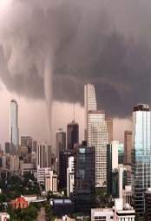
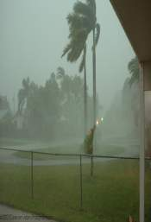
DESTRUCTIVE WEATHER PLANNING
Planning for destructive weather is vital to ensuring the safety of MARFORSOUTH personnel and their families. This handbook contains emergency management information for Broward and Miami-Dade counties and includes: the locations of emergency shelters, grocery stores and gas stations with generator power; emergency services contact information; and, storm surge charts and evacuation routes.
In the event of an evacuation, each zone will be evacuated dependant upon the hurricane’s track and projected storm surge, independent of the hurricane’s category. Upon identification of a threat, the county will use local media to relay pertinent information, such as evacuations and shelter openings. It is important that you monitor the news for this information. Remember that evacuation zones correspond to storm surge; all personnel will need to determine if their home is a safe shelter during a hurricane or other destructive weather event.
This handbook also includes checklists for hurricane preparedness, actions during a hurricane, evacuation and hurricane recovery. The checklists are not exhaustive and provide space to note your individual family needs. This handbook provides information available to date and is subject to change. It is essential that all personnel acquire current information from county emergency management websites and media sources prior to and during destructive weather events.

Slide 12
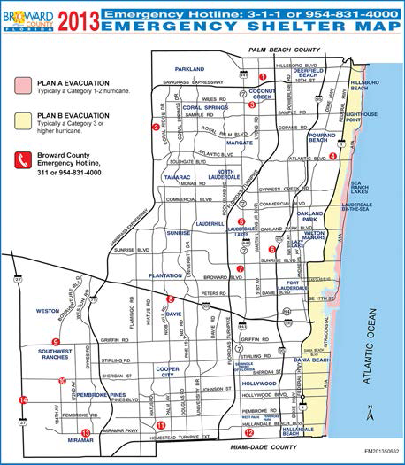
BROWARD EMERGENCY SHELTERS
http://www.broward.org/Hurricane/Pages/EvacuationShelter
Information.aspx
AMERICAN RED CROSS
OPERATED EMERGENCY SHELTERS
1. Lyons Creek Middle School
4333 Sol Press Blvd.,
Coconut Creek 33073
2. Coral Glades High School
2700 Sportsplex Dr,
Coral Springs 33065
3. Monarch High School
5050 Wiles Road,
Coconut Creek 33073
4. Pompano Beach High School
600 N.E. 13th Ave.,
Pompano Beach 33060
5. Park Lakes Elementary School
3925 N. State Road 7,
Lauderdale Lakes 33319
6. Rock Island Elementary/
Arthur Ashe Middle School
1701 N. W. 23rd Ave.,
Fort Lauderdale 33311
7. Plantation Elementary School
651 N. W. 42nd Ave.,
Plantation 33317
8. Fox Trail Elementary School
1250 Nob Hill Road,
Davie 33324
9 Falcon Cove Middle School
4251 Bonaventure Blvd.,
Weston 33332
10 Silver Trail Middle School
18300 Sheridan St.,
Pembroke Pines 33331
11. New Renaissance Middle School
10701 Miramar Blvd.,
Miramar 33025
12. Watkins Elementary School
3520 S. W. 52nd Ave.,
Pembroke Park 33023
13 Everglades High School
17100 SW 48 Court,
Miramar, FL 33027
14 West Broward High School
500 NW 209 Avenue,
Pembroke Pines, FL 33029
Emergency Hotline: 311 or 954-831-4000

Slide 13
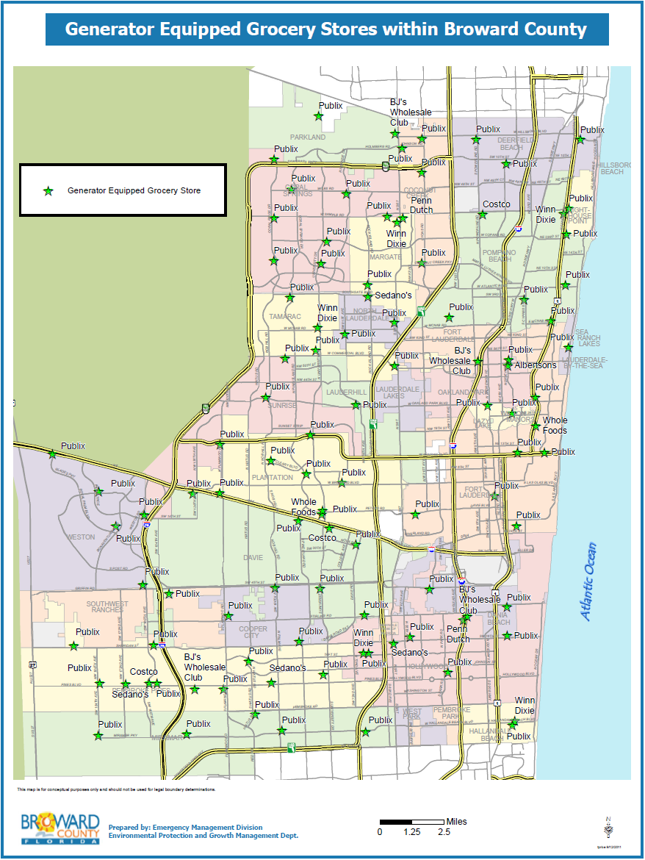
GENERATOR EQUIPPED GROCERY STORES
BROWARD COUNTY
Notes:
http://www.broward.org/Hurricane/Stores/Documents/grocerystores.pdf

Slide 14
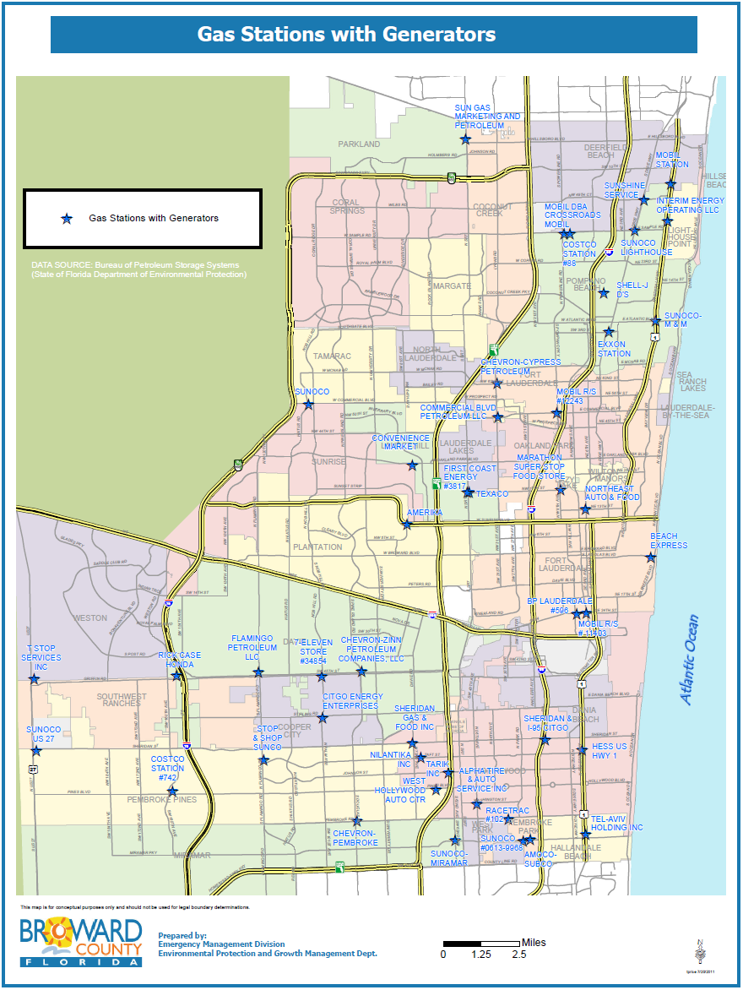
GAS STATIONS PRE-WIRED FOR GENERATOR
POWER – BROWARD COUNTY
Notes:
Source: http://www.broward.org/Hurricane/Stores/Documents/gasstations.pdf

Slide 15
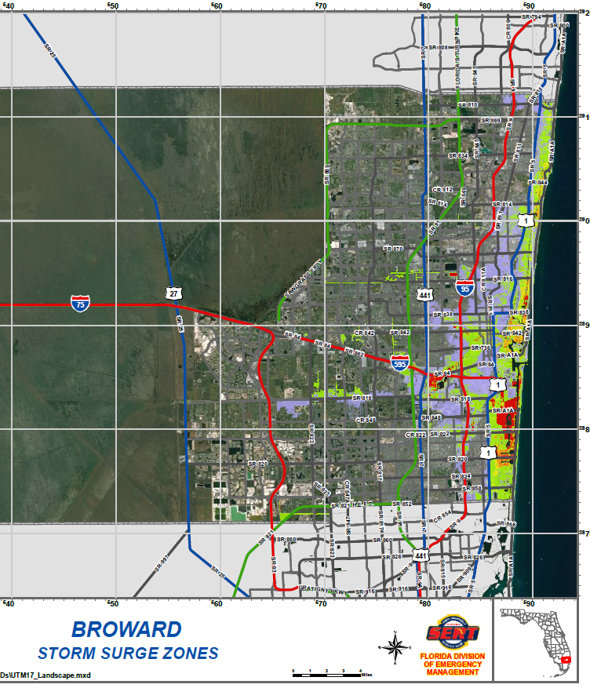
BROWARD STORM SURGE
http://www.floridadisaster.org/publicmapping

Slide 16
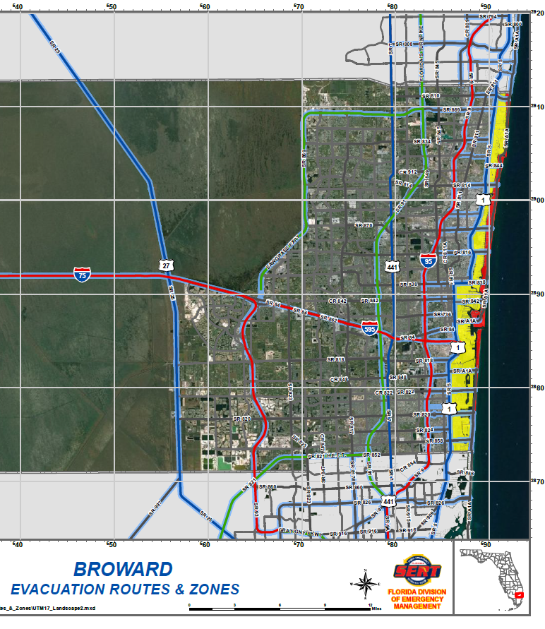
BROWARD EVACUATION ROUTES
http://www.floridadisaster.org/publicmapping

Slide 17
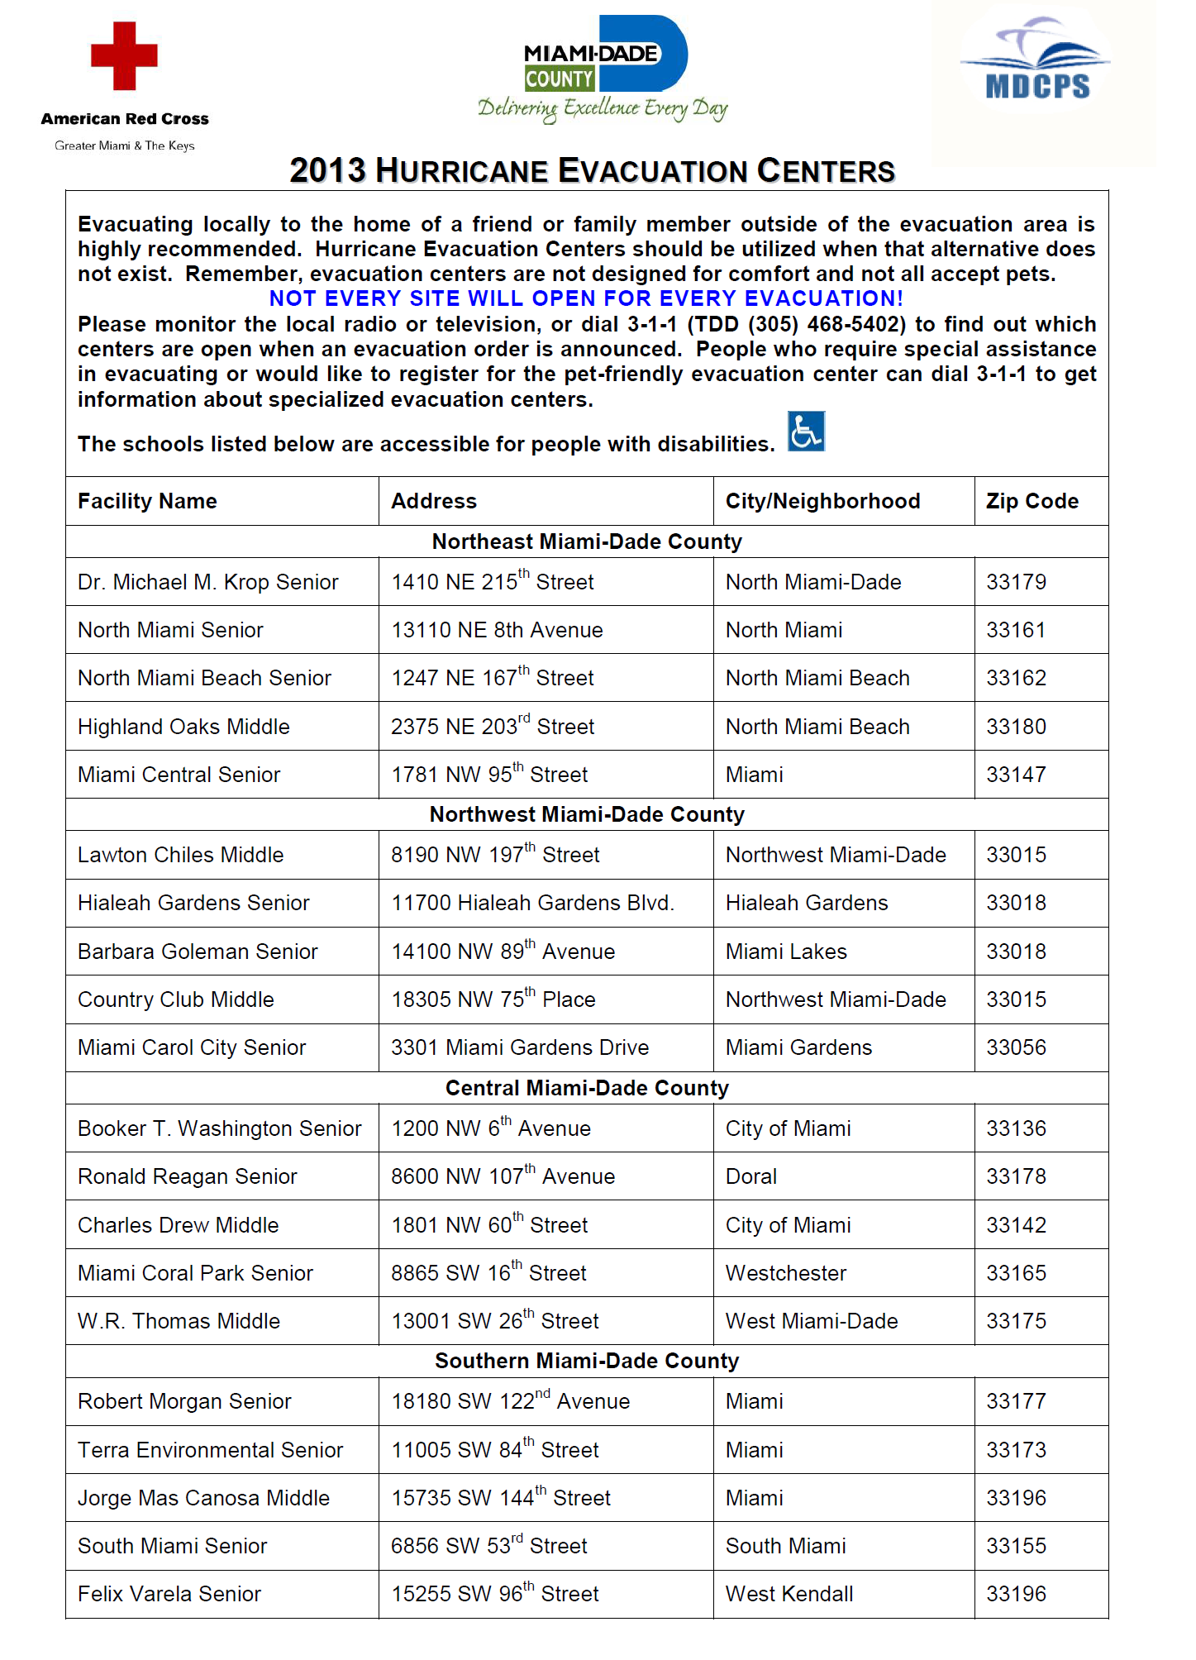
MIAMI DADE EMERGENCY SHELTERS
http://www.miamidade.gov/hurricane/evacuation-assistance.asp

Slide 18
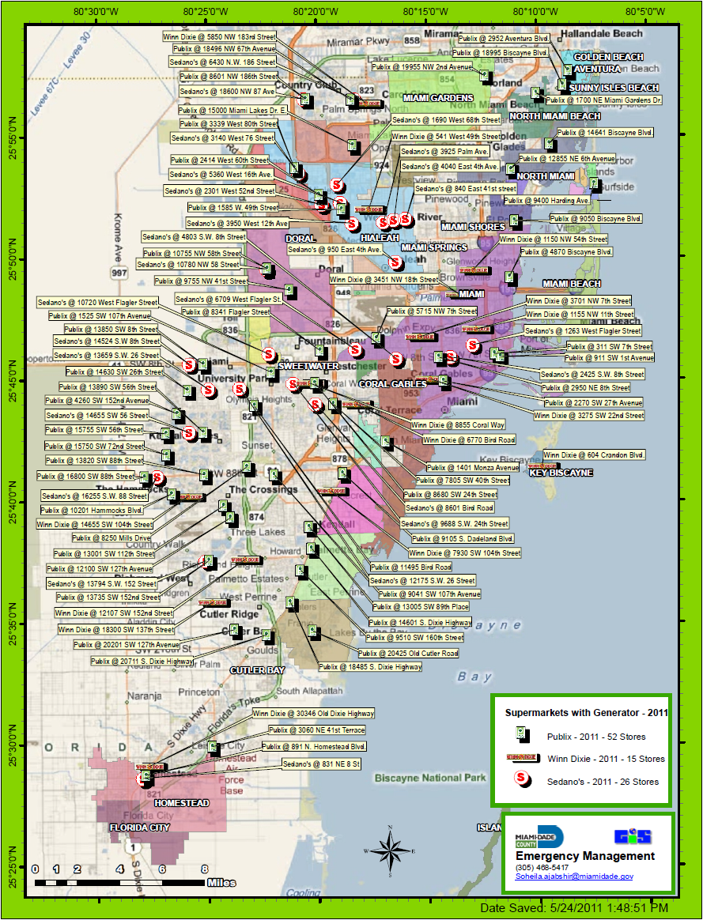
GENERATOR EQUIPPED GROCERY STORES
MIAMI-DADE COUNTY
Notes:
http://www.broward.org/Hurricane/Stores/Documents/grocerystores.pdf

Slide 19
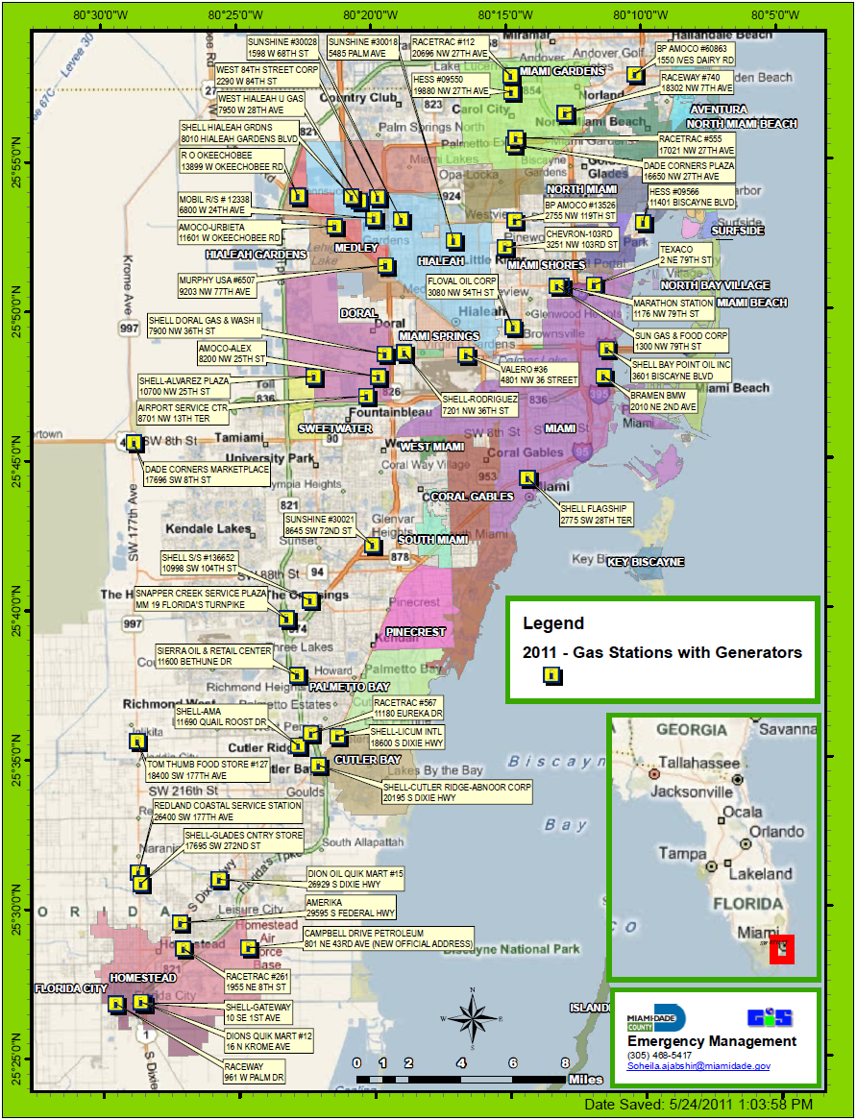
GAS STATIONS PRE-WIRED FOR GENERATOR
POWER – MIAMI-DADE COUNTY
Notes:
Source: http://www.broward.org/Hurricane/Stores/Documents/gasstations.pdf

Slide 20
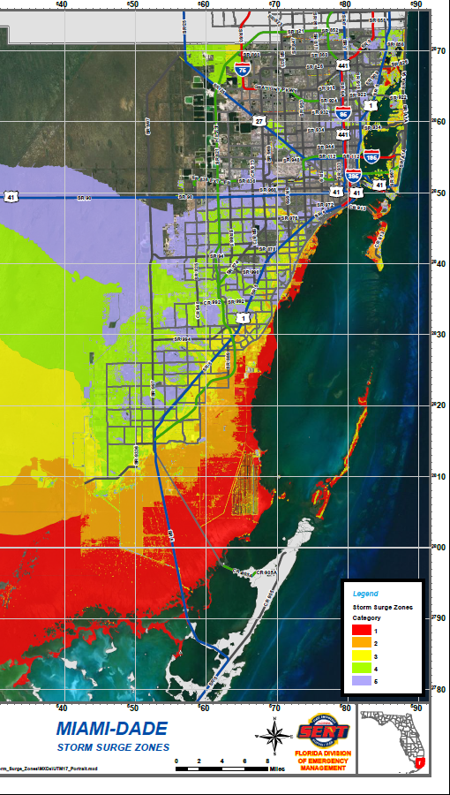
MIAMI DADE STORM SURGE
http://www.floridadisaster.org/publicmapping

Slide 21
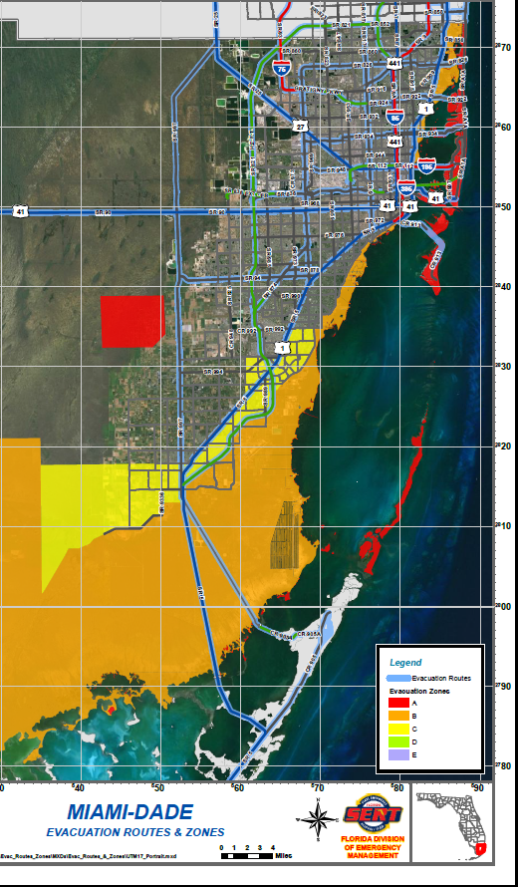
MIAMI DADE EVACUATION ROUTES
http://www.floridadisaster.org/publicmapping

Slide 22
HURRICANE PREPARATION CHECKLIST
BEFORE THE SEASON
Review your plan of action for survival.
Ensure your plan of action for survival includes pets.
Ensure your plan of action for survival includes family
members with special needs?
If you have home health care service, plan with your agency
for emergency procedures.
If you need assistance with daily living or are electrically
dependent, register with the Miami-Dade Emergency
Evacuation Assistance Program or Broward County’s
Vulnerable Population or Special Needs Registries. (See
pages 26-27 and 31 )
Create a list of people you trust who can assist you.
Post emergency numbers.
Know what you are able to do yourself and what you will
need assistance with in an emergency.
Have a plan to signal you need help (e.g., hanging
something on a door, blowing a whistle, medical alert
system, etc.).
Review, create, and educate your families and friends on
your communication plan. (i.e. – Who will be the one family
member out of state that will be your and the rest of your
friends and relatives POC for updates.)
Determine if you live in a mandatory evacuation zone and
review your county's evacuation plan.
Review or create your evacuation plan.
Ensure you have pre-arranged boat storage or securing
plan.
Ensure you have a plan for valuables, family heirlooms, or
irreplaceable items.
Conduct a home risk assessment and determine if you live
in a safe structure.
Review your insurance plans and ensure you have enough
coverage or if you need to add coverage to reflect new
belongings or home value.
Store extra copies of important documents and photo
negatives off site.
Trim trees and remove coconuts and other yard debris from
yard. (BUT never right before storm.)
Clear gutters and downspouts.
Check roof for loose bricks and leaks and make repairs.
Inventory shutters or obtain materials to protect windows
and doors.
Inventory your personal belongings.
Take “before” photographs or video of exterior and interior
of home vehicles, boats, and RVs.
Check fire extinguishers.
Have generators, chain saws, and other power tools
inspected and serviced.
Ensure your vehicles are inspected and serviced.
Inventory and create hurricane survival kit shopping list
(see page 40).
Inventory sand create evacuation kit shopping list (see
page 39).
Schedule needed purchases for hurricane survival kit and
evacuation kit as to lessen impact of cost and budget
effects.
Discuss the hazards of hurricanes with your children and
encourage them to talk about their fears and explain some
of the things you’ll be doing to keep everyone safe.
Teach your neighbors about what you know about
hurricane preparedness.
Organize your neighborhood to work together.
Ensure your HOA is trimming trees and removing coconuts
and other yard debris from neighborhood common areas.
Haul away debris as a neighborhood.
Use your existing networks such as HOA, religious
organizations, and professional organizations to make
donations and volunteer to help others not as fortunate.

Slide 23
HURRICANE PREPARATION CHECKLIST
DURING APPROACH
Make sure a member of the household monitors weather
reports daily.
Monitor TV and radio media for county and state
instructions.
Initiate communications plan to relay messages to friends
and family on where you are, how you are doing.
Initiate your hurricane survival plan.
Final inventory of hurricane and evacuation kit supplies
(See pages 39-41).
Purchase last minute supplies for hurricane and evacuation
kits.
Finalize and warn others of your evacuation plan.
Map and practice two evacuation routes.
Ensure all vehicles have full fuel tanks.
Ensure any final vehicle repairs are completed.
Ensure generators are full of fuel.
Turn up refrigerator to maximum cold and keep closed.
Make as much ice as possible for use in coolers or
purchase ice and store in freezer until needed.
Stage and prepare coolers.
Fill bathtub and large containers with water.
Store lawn furniture, garbage cans, and other loose yard
and home objects.
Ensure all rechargeable power tools are charged and ready
for use.
Ensure power tools are full of fuel.
Shutter all windows and doors.
Turn off pool pump and vacuums.
Ensure irrigation systems are turned off.
Prepare, store, or secure boat.
Turn off utilities if told to do so by authorities.
Turn off propane tanks.
Unplug small appliances.
Prepare and execute your plan of action for your pets.
Fill prescriptions.
Dialysis patients prepare for treatment.
Obtain cash (a few hundred dollars).
Pack evacuation kit supplies.
Ensure vehicles are parked facing the direction you would
travel to leave your residence.
Prepare and stage to evacuate.
Evacuate upon orders from authorized officials.
Notes:
COMMUNICATIONS PLAN:
1: Have a out of state number to relay all your calls to like a family or friend. Train your family to call that number instead of trying to reach you here.
That way fewer calls are coming in to what is left of the phone system, and you only have to make one call to let as many people as you can know that you are OK.
You can also relay phone calls to your insurance agent to a more reliable number.
2. Weather- Be sure someone in the household is watching the weather report daily - many people got caught off guard by Hurricane Andrew and Irene.

Slide 24
HURRICANE PREPARATION CHECKLIST
DURING HURRICANE
Stay indoors at all times.
Stay indoors until given the “all clear” signal or other
instructions by authorized personnel.
Take refuge if outside or traveling.
Do not stay in cars.
Monitor radio or TV for emergency updates and
instructions.
Protect yourself inside your house by staying low and in the
center of the house or in a strong room.
Remain on first floor of house if possible.
Stay away from windows and doors.
Go indoors to your designated shelter-in-place room/area.
Close and lock all windows.
Close, lock, and brace all exterior doors.
Close all interior doors.
Close all vents.
Turn off gas and propane.
Turn off electricity.
Use flashlights and lanterns if light is required.
Turn off water.
Make sure family members and pets are with you and stay
with you.
Ensure your hurricane survival kit is as close to you as
possible.
Avoid using the telephone unless necessary.
Call 911 only for emergencies.
For tornadoes, protect yourself with a mattress or padding.
For fires, breathe through a damp cloth, stay low to the
ground, feel any door before opening with the back of your
hand, and remember stop-drop-and roll.
Don’t use gas, propane, or kerosene appliances indoors or
non-ventilated areas as vapors can be toxic.
Be aware of the “eye” of the storm, as it will seem calm and
as if the storm is over…but wind and rain will return with
greater intensity as it passes.
Once hurricane effects start, remain in place unless ordered
to evacuate or unless no other option exists.
Notes:
COMMUNICATIONS PLAN:
1: Have a out of state number to relay all your calls to like a family or friend. Train your family to call that number instead of trying to reach you here.
That way fewer calls are coming in to what is left of the phone system, and you only have to make one call to let as many people as you can know that you are OK.
You can also relay phone calls to your insurance agent to a more reliable number.
2. Weather- Be sure someone in the household is watching the weather report daily - many people got caught off guard by Hurricane Andrew and Irene.

Slide 25
HURRICANE CHECKLIST
POST DESTRUCTIVE WEATHER
Be patient.
Expect the worst.
Be prepared for communities to change significantly.
Self-sufficiency is the key.
Secure property.
Monitor radio, TV, and NOAA weather radio.
Listen and watch for your county, state, or federal
government to activate their response plan.
Adhere to all public protective measures.
Evacuation orders can come after the storm has subsided
due to damage or follow-on threats, be prepared to execute
in accordance with authorities instructions.
Check home for gas leaks.
Check your home’s power lines.
Don’t connect generators to building wiring.
Check your home’s water lines.
If house floods, have an electrician inspect your home
before tripping power switch.
Don’t use tap water until told to do so by local officials.
Open windows to ventilate and dry home.
Avoid use of telephone except in emergencies.
Use grills outdoors or in well ventilated areas.
Avoid driving.
Watch for closed roads.
Avoid driving on damaged bridges and washout roads.
Avoid down and dangling utility lines and treat all as if they
are powered.
Avoid standing water.
Stay on firm ground and avoid moving water.
Have local ID on you at all times.
Take pictures or videos of all damage to home, vehicles,
and belongings.
Make temporary repairs for safety hazards such as covering
holes or removing debris.
Don’t use power tools you are unfamiliar with.
Contact your insurance company.
Get permits for required repairs or destruction.
Only hire licensed contractors to do home repairs.
Re-inventory all personal belongings.
Retrieve stored documents.
Seek recovery assistance from local, state, and Federal
government if required and you qualify.
Watch for price gouging and report known incidents.
Help your neighbors and community after you have taken
care of yourself and family.
Notes:
SECURE PROPERTY:
If your home is damaged, make sure to secure the openings, and especially the roof to prevent further rain damage.
RE-INVENTORY:
Make a photographic or written list of your personal belongs so you can compare that with your inventory. Have this prepared for your insurance agent and other recovery assistance agencies.
Now is the tie you will need your stored documents like insurance policies, lease, etc.
SEEK RECOVERY ASSISTANCE:
Miami-Dade will open Disaster Recovery Assistance Centers around the community to provide:
Access to emergency services like paramedics
disaster information
recovery supplies and services from American Red Cross and other volunteer agencies

Slide 26
EVACUATION KIT CHECKLIST
Carrying container
Car keys for all vehicles
Bedding (blanket or sleeping bag)
Clothing (3 days)
Personal aids
  Eyeglasses
  Hearing aids and batteries
  Prosthetic devices
Rain wear / Outer wear
Toiletries (3 days)
  Soap
  Deodorant
  Shampoo
  Toothbrush
  Toothpaste
  Washcloth
  Towel
  Female products
Flashlight
Radio (battery powered)
Extra batteries (sizes for all battery operated devices)
Food (high energy / non-perishable – 3 days)
Water (1 gallon per person per day)
Manual can opener
Disposable dinnerware and utensils
Games
Books (2-3)
Personal music device (with headphones)
Identification
Proof of residency
Important papers such as birth certificate, social security
card, marriage certificate, power of attorney, insurance
documentation, etc
Cash (but not too much)
Cell phone
1st Aid kit
  Bet-adine solution
  Gauze bandages
  Adhesive tape
  Sterile pads
  Band aids
  Triangular bandages
  Safety scissors
  Sun screen
  Insect repellent
Medications and prescriptions
Baby needs
  Food/formula
  Diapers
  Wipes

Slide 27
HURRICANE SURVIVAL KIT CHECKLIST
First aid kit
  Aspirin
  Antibiotic cream
  Mosquito repellent
  Sunscreen (45 SPF recommended)
  Gauze bandages
  Adhesive tape
  Sterile pads
  Band aids
  Triangular bandages
  Safety scissors
2 week supply of medications (and copy of prescriptions)
Large trash bags (lots of them)
Unscented bleach (add 8 drops of bleach per gal)
Soap and liquid detergent
Plastic bags (assorted sizes of zip locks)
Tool box (with assorted tools for minor repairs)
ABC rated fire extinguisher
Masking tape or duct tape
Outdoor extension cords
Spray paint
Roofing tarps or plastic sheeting
Heavy work gloves
Sturdy shoes
Change of clothes
Rain gear
Extra glasses or contacts
Money (Cash, but not too much)
Maps of the area with landmarks on it
Local phone book
List of all your important contacts (family, doctors,
insurance agents)
Banking information
Leases / mortgage
Proof of occupancy (such as utility bill)
Photo inventory of your personal belongings
Insurance papers
Waterproof container to keep the documents in
Keep loose items in airtight plastic bags.
Gather the kit’s items in easy-to-carry containers or duffel bags.
Put them within reach, near the exit you use most often.
Your Hurricane Survival Kit should include 3 to 14 days supply.
Drinking water (1 gallon - per person - per day)
Nonperishable foods
  Canned meat/fish
  Canned fruit/vegetables
  Dried fruit
  Bread in moisture proof packaging
  Cookies/Candy
  Power/granola bars
  Canned soups
  Non-perishable milk
  Packaged condiments
  Peanut butter and jelly
  Instant tea/coffee
  Powdered or single serve drinks
Manual can opener
Sterno fuel
Portable camp stove/grill
Stove/grill fuel (charcoal w/ lighter fluid or propane)
Waterproof matches / butane lighter
Disposable eating utensils, plates, and cups
Grilling utensils
Napkins and paper towels
Aluminum foil
Oven mitts
Standard single line phone (that does not require
electricity)
Flashlight (1 per person)
Portable battery powered lanterns
Battery operated radio
Extra batteries (ensure sizes match all battery operated
devices)

Slide 28
HURRICANE SURVIVAL KIT CHECKLIST
Toiletries
  Soap
  Deodorant
  Shampoo
  Toothbrush
  Toothpaste
  Washcloth
  Towel
  Female products
Toilet paper
Bedding:
  Pillows
  Sleeping bags
Pet supplies
  Water (1/2 gallon per day) for pets
  Litter box and supplies
  Carrying container
  Dry and/or canned food
  ID tags and collars
  Proof of recent immunizations
Baby supplies
  Disposable diapers
  Formula, food and medication
  Bottles and feeding utensils
Entertainment
  Books
  Games
  Toys

Slide 29
ADDITIONAL BROWARD/MIAMI DADE SERVICES
Broward Country: Vulnerable Population Registration
http://www.broward.org/registry/Pages/Default.aspx
The Vulnerable Population Registry is for residents who are at risk due to disability, frailty or health issues, regardless of age, who elect to stay at home in the event of a hurricane or other emergency. Public safety officials in your city may use the Vulnerable Population Registry to assist for planning purposes only in their response to an emergency and does not guarantee that you will be provided assistance.
You can register online or by calling 311 in Broward or 954-831-4000 (TTY 954-831-3940), or your city's emergency management agency.
Broward Country: Special Medical Needs
http://www.broward.org/AtRisk/Pages/Specialmedical.asp
If you have a medical condition that requires a greater level of care than that provided at a General Population Shelter, but you do not require hospitalization or a medical institution, a Special Needs Shelter may be appropriate for you. These shelters offer basic medical assistance and monitoring. They are staffed by qualified medical personnel and have back-up electricity for limited lighting and essential medical equipment. Family members and caregivers are encouraged to accompany you.
Evacuation Transportation
  Evacuation transportation services to and from your pre-planned shelter destination, including transfer assistance, are available, through either BCT fixed route service or Paratransit (TOPS).
To request or obtain an application for a Special Needs Shelter and/or Paratransit evacuation transportation, including applications in alternative formats, call Broward County Human Services at 954-357-6385 (or TTY 954-357-5608). You can also download and print an application online.
Miami Dade Country: Emergency Evacuation Assistance Program
http://www.miamidade.gov/fire/evacuation-program.asp
Miami-Dade residents who require daily skilled nursing care, assistance with daily living, or have life-saving medical equipment dependent on electricity should register for the Special Needs & Emergency Evacuation Assistance Program (PSN/EEAP). This program is specifically for those individuals who live alone or with their families, and not in a managed care facility such as an assisted living facility (ALF) or nursing home
Register with MDFR by contacting 3-1-1 or 305-513-7700; or 888-311-DADE or 305-468-5402 (TDD/TTY); or they can also be downloaded from the website.
When disasters occur, people need to evacuate their homes quickly to get to a safe location. Due to their medical or other conditions, some Miami-Dade County residents will need assistance to do this. The PSN/EEAP has been developed for County residents who need help when an emergency evacuation is necessary.

Slide 30
IMPORTANT PHONE NUMBERS & WEBSITES
EMERGENCIES DIAL - 911
MARFORSOUTH Command Duty Officer . . (305) 437-0518
US Southern Command Weather Hotline . . (305) 437-3919
The American Red Cross Broward County . (954) 797-3800
The American Red Cross Greater Miami & The Keys . (305) 644-1200
Broward County Emergency Operations Center . (954) 831-3900
Broward County Hurricane Hotline . . (954) 831-4000
Miami-Dade Special Needs Hotline . . (305) 513-7700
Miami-Dade Emergency Management . . (305) 468-5400
Miami-Dade County Emergency Operations Center (305) 468-5900
State Emergency Operations Center . . (800) FL-HELP1
Florida Emergency Information 24-hour hotline . (800) 342-3557
The Citizens Response Center (evacuation questions) . (813) 272-6900
Florida Highway Patrol (road problems) . . (813) 632-6859
Insurance Companies and Adjusters . . (800) 22-STORM
Army Corps Of Engineers (Operation Blue Roof) . (888) 766-3258
The American Red Cross Broward, Greater Miami & The Keys http://www.miamiredcross.org
Broward County Emergency Management Agency
http://www.broward.org/disaster
Broward County Hurricane Center
http://www.broward.org/hurricane
Federal Emergency Management Agency (FEMA)
http://www.fema.gov
http://www.miamidade.gov/oem/
National Hurricane Center
http://www.nhc.noaa.gov/
National Weather Service Hurricane Links
http://www.weather.gov/os/hurricane/
NOAA Weather Radio All Hazards
http://www.weather.gov/nwr/
State of Florida Emergency Management
http://www.floridadisaster.org
POST THESE NUMBERS NEAR HOME PHONE
ENTER/SAVE NUMBERS IN CONTACTS ON CELL PHONES

